Slide 1

Ace of Hearts
Mia Giandinoto, Hannah Hagenau, Anna Johnson, Shivani Kulkarni, Dhruv Modi, Sherina Thomas, Matthew Tran
September 10th, 2020

Slide 2
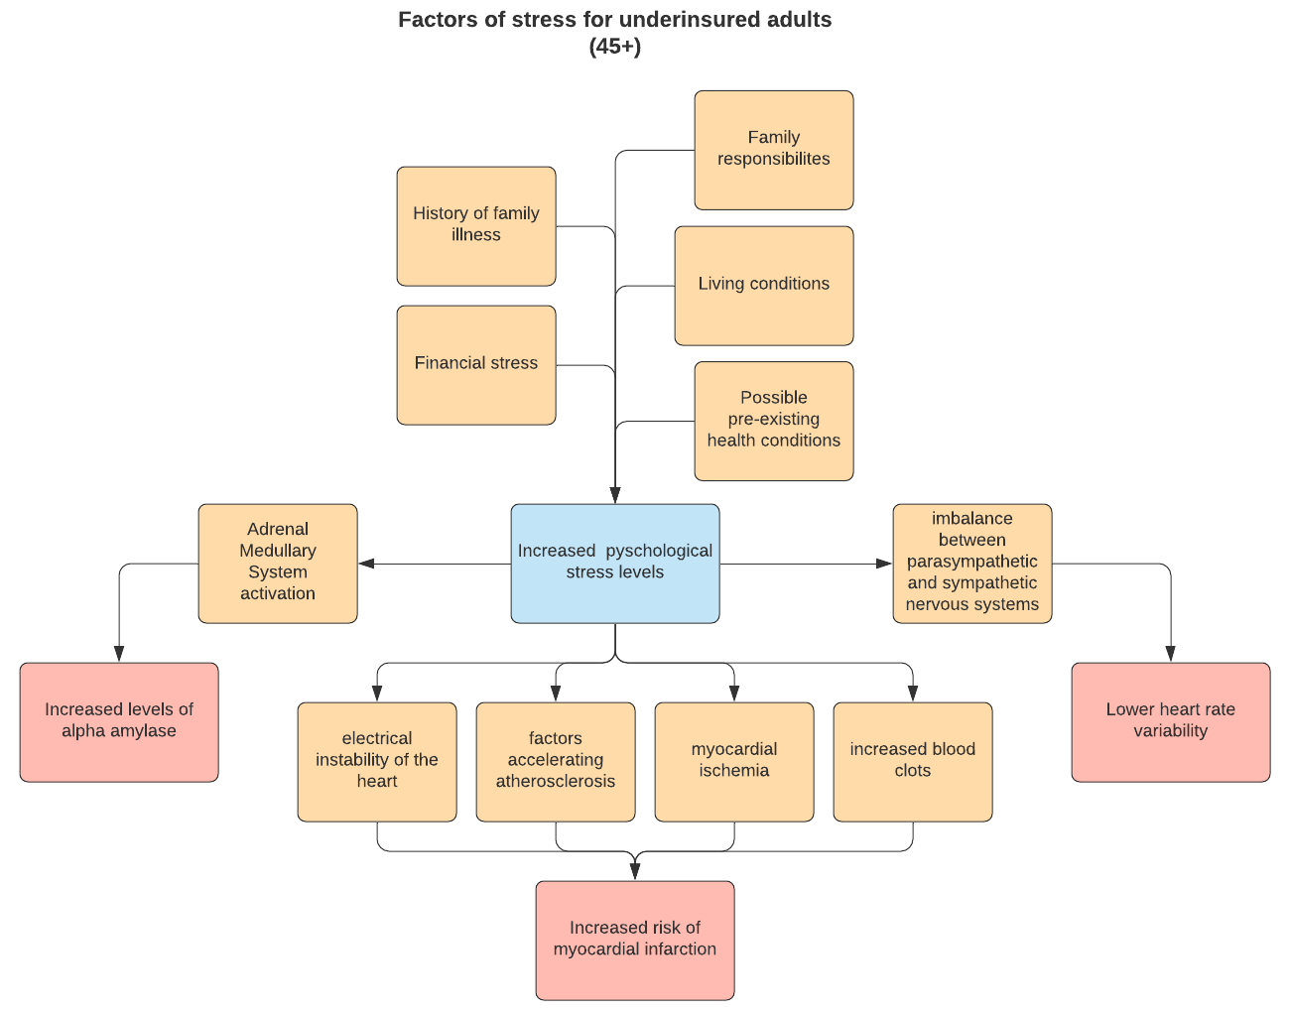
Overview/
Health Disparity
Target Population:
Uninsured/underinsured adults have less access to health care¹⁶
Less screening and monitoring
Medicare starts at 65
Adults over the age of 45 are at higher risk for heart attack (especially men)
Notes:
How to help joe.

Slide 3
Problem Statement/Design Inputs
Stress has been shown to cause numerous cardiovascular complications and is a risk factor for myocardial infarctions⁶, especially in the middle-aged population and above (45-65)⁶. Time is a critical factor in recognizing symptoms and treating heart attacks³; providing a noninvasive, biosensing and/or ECG based device that can monitor stress and heart attack warning signs in a timely manner has the potential to mitigate the effects of a myocardial infarction.
Value
To reduce fatality in underinsured patients over the age of 45 at risk of a heart attack by alerting patients and their caretakers when their stress levels are high and/or symptoms of heart attacks are present, allowing for earlier treatment.
Data
ECG data
R point, ST segment elevation¹, Q peak depth¹³, T-wave inversion¹
HRV data (LF/HF ratio)
Voltage output from uv absorption
>2.6 mg/ml saliva¹⁷
Notes:
Our plan to help
Constraints
Sensitivity VS Sensibility
Convenience of use
Limitations of non-continuous testing
Problem Statement: Cardiovascular disease (CVD) is the number one cause of death worldwide. Deaths from CVD have been increasing, particularly among the elderly (70+) population. Stress has been shown to cause numerous cardiovascular problems, including atherosclerosis, which is a risk factor for myocardial infarction (heart attack)². Stress is also known to trigger heart attacks². Time is a critical factor in treating heart attacks - the optimal time to treat is within 1 hour and delaying treatment for even a short time decreases life expectancy³, Despite this fact, many people do not seek treatment in a timely manner because they cannot recognize their symptoms as that of a heart attack³. And providing a noninvasive, ECG or biosensing based device that can both monitor stress and detect heart attack warning signs has the potential to provide short and long term protection from these myocardial infarctions.

Slide 4
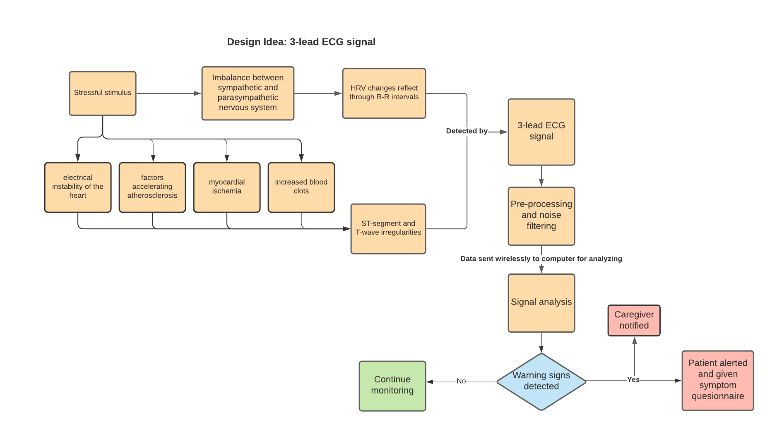
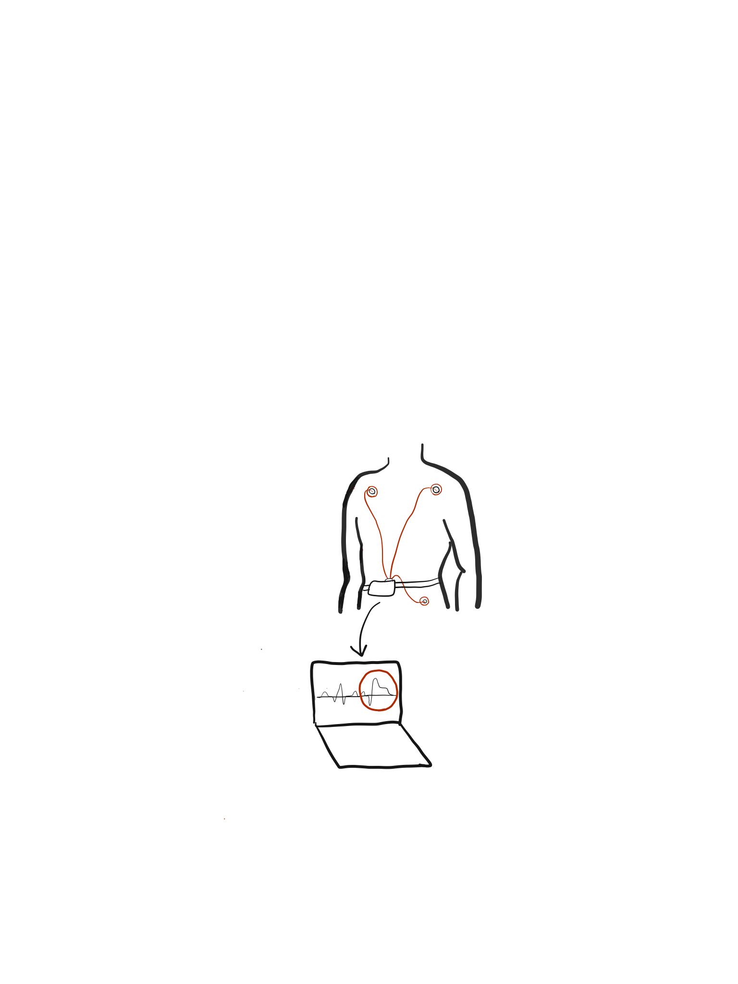
Device 1 - Portable ECG
Constraints
Physical activity induced variation
Limited power supply
Low specificity
Monitors ECG signals for ST segment/T wave irregularities²
Neural network trained with PTB database data
Extracts and analyzes Heart Rate Variability (HRV)
Signal acquired via 3-lead system, amplified, filtered, and analyzed(.5-100 Hz)¹¹
Constant monitoring, high sensitivity
Notes:
Monitors ECG signals for ST segment/T wave irregularities
Extracts and analyzes Heart Rate Variability (HRV) for stress monitoring
Signal acquired via 3-lead system, amplified, and filtered
Mention questionnaire, the fact that we are helping people recognize non-traditional symptoms if heart attacks
Discrete Wavelet Transform
Data sent wirelessly to computer for analysis (can just be mentioned in presentation)
If warning signs detected
Symptom questionnaire and alert sent to user
Alert sent to caregiver

Slide 5
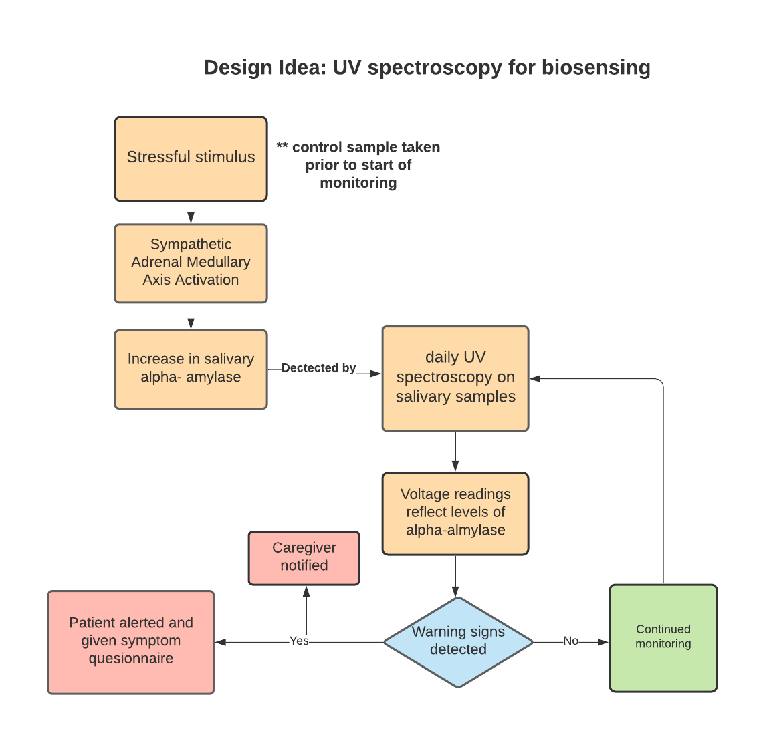
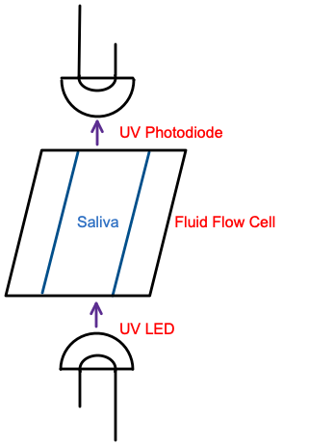
Device 2 - UV Absorbance Spectrometry
UV spectroscopy measuring salivary alpha-amylase(sAA) concentrations
sAA biomarker absorbs light (282 nm)¹⁰
UV photodiode generates voltage
Higher-than-normal levels indicate stress(>2.6 mg/mL)¹⁷
Elevated sAA levels correlated with MI¹³
Constraints
Cost of biomarker and microfluidics materials
Low Sensitivity
Confounding substances at wavelength
Diode variability
Limitations of non-continuous testing
Notes:
Raymond’s feedback: Interferometer needed? Put this in supplement slide bc it feels like extraneous information. Serious doubts about it being this simple especially w/out microfluidics. Can UV be used to detect troponin? Other proteins likely to interfere with wavelength.
Ray, P., & Steckl, A. J. (2019, March 22). Label-Free Optical Detection of Multiple Biomarkers in Sweat, Plasma, Urine, and Saliva. Retrieved August 25, 2020, from https://pubs.acs.org/doi/10.1021/acssensors.9b00301
O'Toole, M., & Diamond, D. (2008). Absorbance Based Light Emitting Diode Optical Sensors and Sensing Devices. Sensors (Basel, Switzerland), 8(4), 2453–2479. https://doi.org/10.3390/s8042453

Slide 6
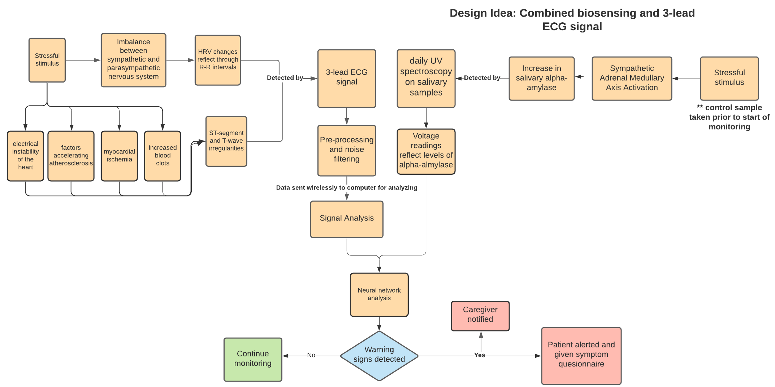
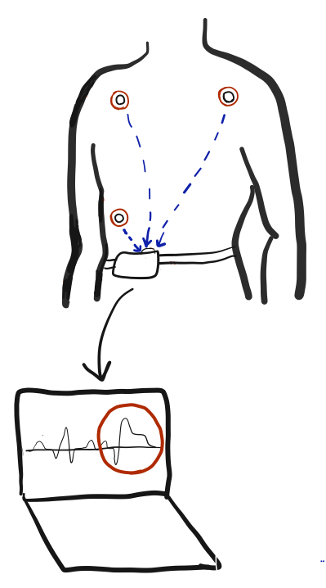
Device 3 - ECG and Alpha Amylase
Constraints
Limited power supply
Cost of microfluidics materials and sAA (for testing)
Combination device for detection of stress and heart attacks
ECG, HRV, sAA detection
Analyzes ECG for irregularities
Integrated stress analysis with neural network
Wireless model
Notes:
Combination device for detection of silent heart attacks
ECG and HRV component of device 1
Tracks long term stress
Analyzes ECG for irregularities indicative of heart attack
“Catches” heart attacks as they happen, helps user identify that they are having heart attack
Spectroscopy component of device 2
Integrated analysis with neural network
Possibly fuzzy ARTMAP

Slide 7
Questions
How can the LF/HF ratio be mapped and analyzed to detect high levels of stress?
What is the optimal arrangement of ECG leads that takes comfort and sensitivity to data into account?
How do physical activity and sleep affect ECG data collection?
What is the most efficient way to detect ECG irregularities(derivative analysis, Pan-Tomkins algorithm, SAT method, neural network)?
How many times a day must the user test sAA levels in order to accurately model stress levels?
How do varying concentrations of alpha-amylase mathematically alter voltage readings (linearly, exponentially, etc.)?
What is the most efficient mode to integrate and analyze HRV frequency data (continuous) and sAA measurements(discrete)?
Notes:
Raymonds feedback: Research HRV as a indicator of stress/heart attack. Talk about at least one frequency and one raw metric(different metrics are in the files he shared).***einthoven’s triangle(wrist or ankle??)

Slide 8
References
Ansari, S., et al. (2017). "A Review of Automated Methods for Detection of Myocardial Ischemia and Infarction Using Electrocardiogram and Electronic Health Records." IEEE Reviews in Biomedical Engineering 10: 264-298.
Chowdhury, M. E. H., et al. (2019). "Wearable Real-Time Heart Attack Detection and Warning System to Reduce Road Accidents." Sensors (Basel, Switzerland) 19(12): 2780.
Dracup, K., et al. (2008). "Acute coronary syndrome: what do patients know?" Archives of internal medicine 168(10): 1049-1054.
Heart attack. (2020, June 16). Retrieved September 09, 2020, from https://www.mayoclinic.org/diseases-conditions/heart-attack/symptoms-causes/syc-20373106
Francis, J. (2016). "ECG monitoring leads and special leads." Indian Pacing and Electrophysiology Journal 16(3): 92-95.
Kivimäki, M. and A. Steptoe (2018). "Effects of stress on the development and progression of cardiovascular disease." Nature Reviews Cardiology 15(4): 215-229.
MISHRA, V., PATIL, R., KHANNA, V., TRIPATHI, A., SINGH, V., PANDEY, S., & CHAURASIA, A. (2018). Evaluation of Salivary Cardiac Troponin-I as Potential Marker for Detection of Acute Myocardial Infarction. Journal of Clinical & Diagnostic Research, 12(7), 44–47. https://doi.org/10.7860/JCDR/2018/32109.11791
O'Toole, M., & Diamond, D. (2008). Absorbance Based Light Emitting Diode Optical Sensors and Sensing Devices. Sensors (Basel, Switzerland), 8(4), 2453–2479. https://doi.org/10.3390/s8042453
Rad, M. Z., et al. (2015). "Real Time Recognition of Heart Attack in a Smart Phone." Acta informatica medica : AIM : journal of the Society for Medical Informatics of Bosnia & Herzegovina : casopis Drustva za medicinsku informatiku BiH 23(3): 151-154.
Ray, P., & Steckl, A. J. (2019, March 22). Label-Free Optical Detection of Multiple Biomarkers in Sweat, Plasma, Urine, and Saliva. Retrieved August 25, 2020, from https://pubs.acs.org/doi/10.1021/acssensors.9b00301
Serhani, M. A., et al. (2020). "ECG Monitoring Systems: Review, Architecture, Processes, and Key Challenges." Sensors (Basel, Switzerland) 20(6): 1796.
Shaffer, F. and J. P. Ginsberg (2017). "An Overview of Heart Rate Variability Metrics and Norms." Frontiers in public health 5: 258-258.
Shen, Y. S., Chen, W. L., Chang, H. Y., Kuo, H. Y., Chang, Y. C., & Chu, H. (2012). Diagnostic performance of initial salivary alpha-amylase activity for acute myocardial infarction in patients with acute chest pain. The Journal of emergency medicine, 43(4), 553–560. https://doi.org/10.1016/j.jemermed.2011.06.040
Villegas, A., et al. (2019). "Arm-ECG Wireless Sensor System for Wearable Long-Term Surveillance of Heart Arrhythmias." Electronics 8(11): 1300.
Beckers, F., et al. (2006). "Aging and nonlinear heart rate control in a healthy population." American Journal of Physiology-Heart and Circulatory
Stress in America: Uncertainty about Healthcare. (2018, January 24). Retrieved September 09, 2020, from https://www.apa.org/news/press/releases/stress/2017/uncertainty-health-care.pdf
Steckl, A. J., & Ray, P. (2018). Stress Biomarkers in Biological Fluids and Their Point-of-Use Detection. ACS Sensors, 3(10), 2025–2044. https://doi.org/10.1021/acssensors.8b00726

Slide 9
Enlarged ECG Flowchart

Slide 10
Enlarged ECG Flowchart

Slide 11
Enlarged ECG+UV Flowchart

Slide 12
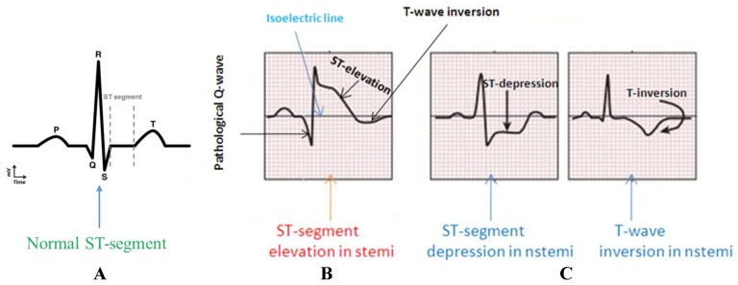
ECG Signal and Features
STEMI characterized by:
ST elevation and T-wave inversion²
N-STEMI characterized by:
ST depressions and/or T-wave inversions²
Notes:
Raymond’s feedback: ***we need assumptions. This could be a supplemental slide.

Slide 13
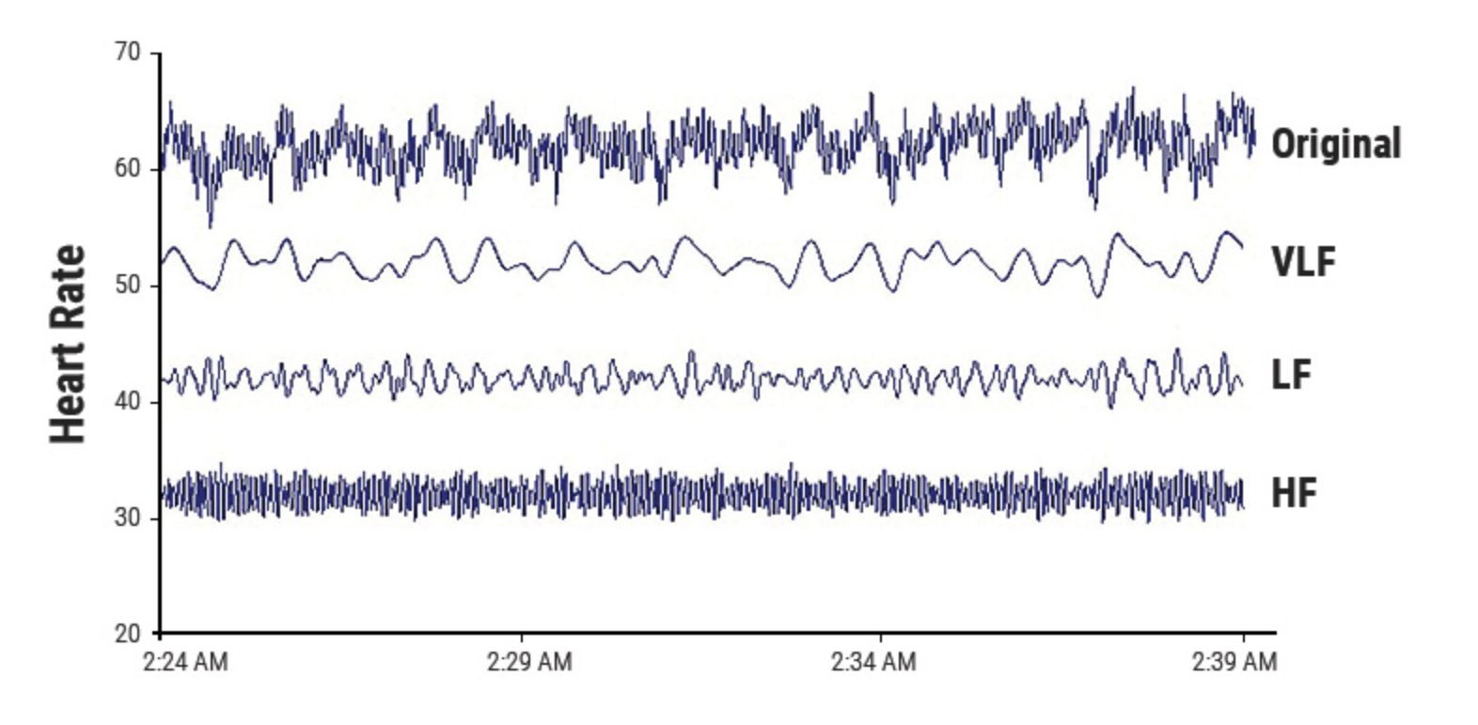
HRV
ECG→R peak detection→ RR Intervals → Tachogram→ FFT and Power Spectral analysis→ Analysis
LF ranges from 0.04-0.15 Hz¹²
recorded over 2 min
PNS, SNS, and BP regulation
HF ranges from 0.15-0.4 Hz¹²
recorded over 1 min
parasympathetic and respiratory activity
Low power reflects stress
LF/HF Ratio
Reflects balance between SNS and PNS¹²
Avg ratio for males = 5.8(day)/3.4(night)¹⁵
Avg ratio for females = 4.4(day)/2.3(night)¹⁵
Low LF/HF ratio associated with high levels of stress¹²
Power Spectral Analysis to determine LF and HF power
Tachogram

